Slide 1
Accelerating Deep Learning by Focusing on the Biggest Losers
Angela H. Jiang, Daniel L.-K. Wong, Giulio Zhou, David G. Andersen, Jeffrey Dean, Gregory R. Ganger, Gauri Joshi, Michael Kaminsky, Michael A. Kozuch, Zachary C. Lipton, Padmanabhan Pillai

Slide 2

Deep learning enables emerging applications
Notes:
Over the last decade, deep neural networks have become a fundamental buildling block of applications, including AlphaGo, autonmous vehicles, translation systems and medical imaging

Slide 3
DNN training analyzes many examples
Notes:
However, it’s hard to create these underlying DNNs. The way these models work, is you show them examples of what it's supposed to be predicting. For instance, if you want your DNN to be able to recognize pedastrians, you need to show it millions of examples of different pedestrians over and over and over again. You can imagine, that this takes a lot of time and computing resources.

Slide 4
Selective-Backprop prioritizes useful examples
Notes:
Our technique, SB, carefully selects what examples to prioritize, so that the DNN trains faster and the resulting DNN is more accurate

Slide 5
Labeled datasets are getting larger
ImageNet: 15 million images
OpenImages: 9 million images
Production datasets are often much larger
Google JFT dataset: 300 million examples
amazon click-through data
Uber autonomous vehicle training video
Notes:
One cure for reducing model error is to make ever-larger datasets. Sometimes so large that we cannot train on all the data. This might be in contrast with what you’ve heard, which is that more labeled data is always better. But in practice, we often have more Images than we have time or resources to train with. For instance, most machine learning developers do not train on ImageNet from scratch because it takes too long.
The motivation for this project is that labeled dataset are getting larger. So large, that we often cannot train on all the data. This might be in contrast with what you’ve heard, which is that more labeled data is always better. But in practice, we often have more Images than we have time or resources to train with. For instance, most machine learning developers do not train on ImageNet from scratch because it takes too long. This problem is even more common in industry. While large tech companies have lots of machines, they also have a growing wealth of data. For instance, you’ll never be able to train through all of Google’s click through data

Slide 6
Selective-Backprop (SB)
SB prioritizes high-value training examples for DNN model training
SB achieves faster convergence per training example
SB is practical
Scalable
Lightweight
Self-paced
Notes:
- By focusing on high-value examples, we are able to reach target accuracies faster
- Also, we show that we are able to guide the network to a better solution to get a higher final accuracy

Slide 7
Introduction
DNN Training Overview
Selective-Backprop Approach
Selective-Backprop Evaluation
Conclusion

Slide 8
Introduction
DNN Training Overview
Selective-Backprop Approach
Selective-Backprop Evaluation
Conclusion

Slide 9
Overview of training cycle
Notes:
Can we avoid doing the backwards pass so often? What if there are examples that are more surprinsing that teach the ntwork more than others?
Backward pass is when the network is learning, so you can learn more from surprising examples

Slide 10
Introduction
DNN Training Overview
Selective-Backprop Approach
Selective-Backprop Evaluation
Conclusion

Slide 11
Can we select high-value training examples?

Slide 12
Using loss as an indicator of usefulness

Slide 13
Relative loss fluctuates over training

Slide 14
SB uses output of the forward pass

Slide 15
Backprop is more expensive than forward pass
K20
GTX 1070
TitanV

Slide 16
Selective-Backprop approach
Forward propagate example
through the network
Calculate usefulness of
backpropping example
based on its accuracy
“Flip a coin” to determine if
we should backprop
Notes:
Be more explict about the connection between surprisingness and probability that you selecrt it
We come up with this probability so that images that we have the most to learn from are most likely to be backpropagated

Slide 17
Calculating probability of backprop
Percentile
Probability
Historical Losses
Percentile
Notes:
Where the size of the vector corresponds to the number of classes we have
We denote the class the example belongs to, with a 1 at that index
Strength of our belief, normalized to sum up to one
We’re choosing to backprop this thing because we’re currently bad at it. Of course, this may change over the course of training.

Slide 18
Selective-Backprop’s usefulness metric
= [0, 0, 1]
= [0.1, 0.3, 0.6]
= 0.509
= 0.509
Notes:
Where the size of the vector corresponds to the number of classes we have
We denote the class the example belongs to, with a 1 at that index
Strength of our belief, normalized to sum up to one
We’re choosing to backprop this thing because we’re currently bad at it. Of course, this may change over the course of training.

Slide 19
Introduction
DNN Training Overview
Selective-Backprop Approach
Selective-Backprop Evaluation
Conclusion

Slide 20
Experimental Setup

Slide 21
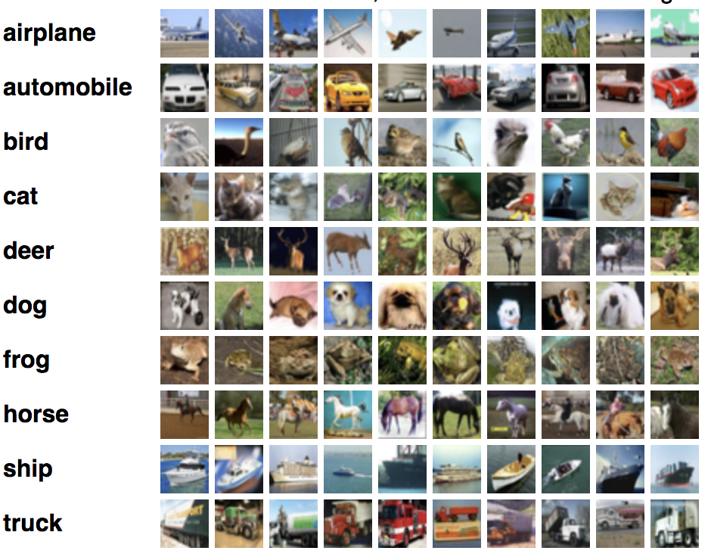
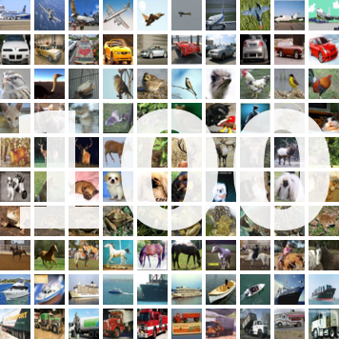
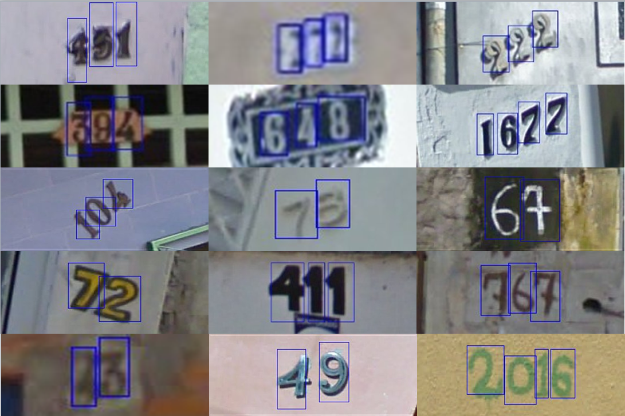
Datasets
CIFAR10
CIFAR100
SVHN
60,000 Training Images
60,000 Training Images
604,388 Training Images
Notes:
Update SVHN # training examples
Swap cifar10 and svhn

Slide 22
Approaches
Baseline
No filtering
Katharopoulos18
Static selectivity
Selective-Backprop (Us)

Slide 23
Katharopoulos18’s approach

Slide 24
Katharopoulos18’s approach

Slide 25
Katharopoulos18’s approach
Static selectivity = 3 / 5
P=0.2
P=0.4
P=0.1
P=0.2
P=0.1

Slide 26
Katharopoulos18’s approach
Static selectivity = 1 / 5
P=0.9
P=0.9
P=0.1
P=0.3
P=0.8

Slide 27
SB saves training iterations on CIFAR10
Notes:
Baseline error: 2.45%
SB error: 1.33%
Percent decrease: 46%
Baseline iterations: 0.96
SB Backwards: 0.32
SB Forwards: 1.62
Backwards reduced: 66.67%
Forwards increased: 68.75%
Update titles

Slide 28
SB saves training iterations on CIFAR100
Notes:
Baseline error: 2.45%
SB error: 1.33%
Percent decrease: 46%
Baseline iterations: 0.96
SB Backwards: 0.32
SB Forwards: 1.62
Backwards reduced: 66.67%
Forwards increased: 68.75%
Update titles

Slide 29
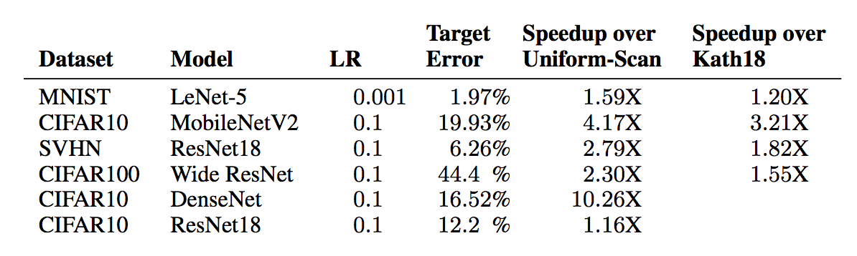
SB accelerates training to target error rate
Notes:
Baseline error: 9.21%
SB error: 7.22%
Error decrease: 22%
Baseline iterations: 12.6
SB Backwards: 7.53
SB Forwards: 28.4
Backwards reduced: 40.24%
Forwards increased: 125.4%
Kath error: 10.04%
Error decrease: 10
YOU MIGHT BE WONDERING WHY

Slide 30
Why does SB perform well?

Slide 31
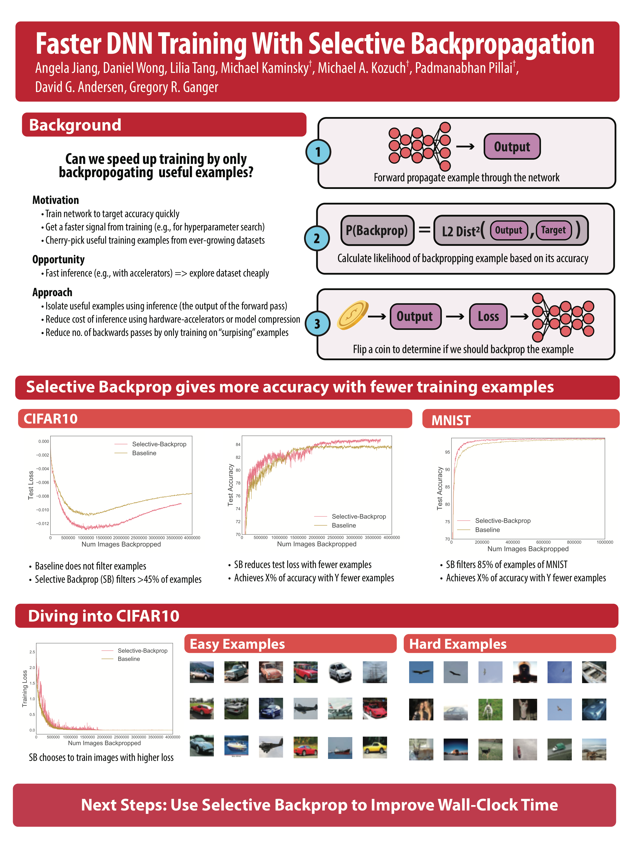
Which examples are hard?
Notes:
They consist of objects from unconvential angles, as well as a lot of small birds with a blue background, likely because it’s hard to know if it’s a ship or a plane.
Use woman in truck as a lead in for the next slide. By focusing on it, we might get worse at understanding trucks

Slide 32
SB on CIFAR10 focuses on hard examples
= [0, 1, 0]
1% examples correct w/ Baseline
29% examples correct w/ SB
= [0.1, 0.3, 0.6]
= 0.3
Notes:
20th percentile, 1% classified correctly by baseline, 29% of examples correc by SB

Slide 33
SB on CIFAR10 focuses on hard examples
Notes:
PRACTICE
Give overview in a couple of sentences. Then explain in detail
SB is sacrificing confidence on earlier examples to have confidence in examples where it’s less confident
In terms of final accuracy, there’s no reward for excess confidence. If you’re over 50% confident, you can make it higher, but it won’t improve your test accuracy
But with low confidence examples, increasing your confidence has high impact on test accuracy
On the second graph, explain why you’re better all the timeoverspecializing to some examples take the 20 % rthat you do the least well on, how well do you do on them

Slide 34
Which images are easy?
Notes:
They consist of easy to classify images, mostly of cars

Slide 35
Which images are hard?
Notes:
They consist of objects from unconvential angles, as well as a lot of small birds with a blue background, likely because it’s hard to know if it’s a ship or a plane.
Use woman in truck as a lead in for the next slide. By focusing on it, we might get worse at understanding trucks

Slide 36
Is SB robust to label error?

Slide 37
SB is robust to modust amounts of error
Notes:
Baseline error: 2.45%
SB error: 1.33%
Percent decrease: 46%
Baseline iterations: 0.96
SB Backwards: 0.32
SB Forwards: 1.62
Backwards reduced: 66.67%
Forwards increased: 68.75%
Update titles
Purple line drops lower, which means we got to a lower error with fewer training iterations. So that’s what I mean by

Slide 38
SB is robust to modust amounts of error
0.1% Randomized
1% Randomized
10% Randomized
Notes:
1.4048, 0.360544 = 74.3% fewer backward passes
55% more forwards passes

Slide 39
Introduction
DNN Training Overview
Selective-Backprop Approach
Selective-Backprop Evaluation
Conclusion

Slide 40
Future work
Selective-Backprop to reduce wall-clock time
Selective-Backprop to isolate mislabeled examples and outliers
Selective-Augment
Notes:
Today, I showed how SB reduces training iterations needed to achieve a target accuracy. However, this comes at the cost of additional forward passes. In the future, we’d like to show the wall-clock savings

Slide 41
Selective-Backprop takeaways
✓
SB prioritizes high-loss examples
Reaches target error rate of CIFAR10 with 68% fewer backprops
✓
SB outperforms static approaches
Trains 2-4.4X faster compared to no filtering
Trains 1.2-3.2X faster compared to approach w/ static selectivity

